Slide 1
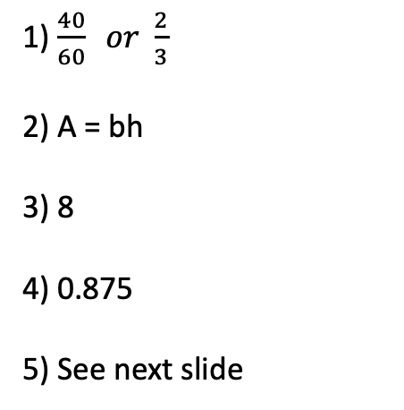
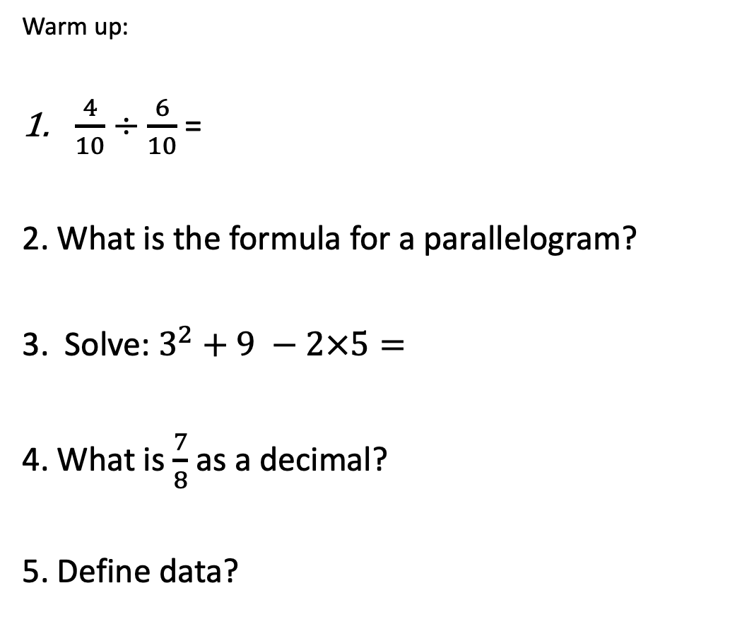
Topic: Data types and Collection
EQ: What are the different types of data
Warm up:
$\frac{4}{10}÷\frac{6}{10}$ =
2. What is the formula for a parallelogram?
3. Solve: $3^{2}+9 −2×5=$
4. What is $\frac{7}{8}$ as a decimal?
5. Define data?
1) $\frac{40}{60} or \frac{2}{3}$
2) A = bh
3) 8
4) 0.875
5) See next slide

Slide 2
Topic: Data types and Collection
EQ: What are the different types of data
Data is a collection of facts, such as numbers, words, measurements, observations or just descriptions of things.
Definition of Data

Slide 3
Topic: Data types and Collection
EQ: What are the different types of data
Data collection can either be primary (collected by you) or secondary (collected by someone else)
What are the different sources of data?
Examples: primary – survey, questionnaire, conducting trials
Secondary – Australian census, bureau of meteorology (weather data), AFL website (player and team statistics)
Data can be classified into two categories
Quantitative (numerical): the answer should be a number
Qualitative (categorical): the answer should be a word
Data
Quantitative (numerical)
Qualitative (categorical)
What are the different types of data?

Slide 4
Topic: Data types and Collection
EQ: What are the different types of data
Examples:
1. The number of goals scored by each team in the FIFA World Cup.
2. The height of each player at an AFL game.
3. The fitness level of everyone in the room (low, medium, high)
4. The city that each person in the room was born.

Slide 5

Topic: Data types and Collection
EQ: What are the different types of data

Slide 6
Topic: Data types and Collection
EQ: What are the different types of data
Quick Write: In your own words explain what Quantitive and Qualitive Data is with examples.
You have 2 minutes.

Slide 7
Topic: Data types and Collection
EQ: What are the different types of data
Task: Data Sort
Copy the two columns below….
Qualitive | Quantitive

Slide 8
Topic: Data types and Collection
EQ: What are the different types of data
The gummy worm increased by 2 inches.
There were four dogs in the group.
The dogs were small.
The sample contained 3 different types of bacteria.
The patient complained of aches and pains.
The patient had a temperature 102 degrees.
The chimp identified 12 pictures correctly.
The parrots range from bright green to dark red.
The balloon increased in size from 5 inches to 8 inches around.
The birds were young.
The rock sample consisted of 25 grams of quartz
The rock sample was reddish brownish.
The sample with the baking soda appeared bubbly
The leaves on the first plant specimen appeared healthier.
The first plant specimen had 3 more leaves than the second specimen.
The leaves on the second plant specimen were green, while the leaves on the first plant specimen were turning brown.
Task: Data Sort
Sort the data below into their type of data, quantitive or qualitive.

Slide 9
Topic: Data types and Collection
EQ: What are the different types of data
Qualitive:
1. The dogs were small.
2. The patient complained of aches and pains.
3. The parrots range from bright green to dark red.
4. The birds were young.
5. The rock sample was reddish brownish.
6. The sample with the baking soda appeared bubbly
7. The leaves on the first plant specimen appeared healthier.
8. The leaves on the second plant specimen were green, while the leaves on the first plant specimen were turning brown.
Quantitive:
1. The gummy worm increased by 2 inches.
2. There were four dogs in the group.
3. The sample contained 3 different types of bacteria.
4. The patient had a temperature 102 degrees
5. The chimp identified 12 pictures correctly.
6. The balloon increased in size from 5 inches to 8 inches around.
7. The rock sample consisted of 25 grams of quartz.
8. The first plant specimen had 3 more leaves than the second specimen.
Task: Data Sort
Answers

